Slide 1
OpenCyc
Commonsense AI Tutorial
STEPHEN L. REED
PRINCIPAL DEVELOPER
TEXAI.ORG
Austin, Texas
Notes:
Texai is an knowledge-based, open source project to create artificial intelligence. The project’s approach is to first construct a bootstrap English dialog system whose goals are to acquire linguistic and common sense skills to improve its own performance. This talk describes the bi-directional grammar that will be used in the dialog system for parsing and generation.

Slide 2
History of the Cyc Project
1982, Japan begins the Fifth Generation Computer project
1982, the Microelectronics and Computer Technology Corp (MCC) formed in response
1984 MCC recruits Doug Lenat from Stanford to create a commonsense knowledge base overcoming the brittleness of then current expert systems
1995 - As corporate sponsorships diminished, the Cyc project was spun-off into Cycorp, the company. The name is a play on an entity in the Babylon 5 TV series
Late 1990’s – Cycorp completes the tenth rewrite of its inference engine and object store and begins its migration from Symbolics Lisp Machines to Linux PCs
1999 Cycorp strengthens its relationships with US military and intelligence community sponsors, which to this day provide the majority of its funding – believing that a commonsense ontology is a hub for integrating disparate military and intelligence systems
2001 – OpenCyc released
2006 – Cycorp implements a Java runtime for its Lisp source code

Slide 3
What is OpenCyc?
Developed by Cycorp, a government sponsored research company in Austin, Texas
A free, comprehensive ontology
Hundreds of thousands of terms, mostly classes of things
Over a million logical statements defining those terms
Manually created by a team of philosophers over a 20 year duration
A large portion is compatible with Resource Description Framework (RDF) the logical language of the Semantic Web
Hosted at SourceForge
Temporarily offline while the proprietary object store and inference engine is converted to Java
Cycorp published OpenCyc in order to promote its ontology as a standard for the semantic web

Slide 4







Cyc Reasoning System
Knowledge
Users
Knowledge
Authors
User Interface
(with Natural Language Dialog)
Other
Applications
Knowledge Entry Tools
Cyc
Cyc API
Reasoning
Modules
Cyc
Ontology &
Knowledge
Base
Interface to
External Data Sources
External
Data
Sources
Data
Bases
Web
Pages
Text Sources
Other KBs

Slide 5
What Gap in AGI Does OpenCyc Fill?
A world model is required by any general problem-solving AI
Concepts in the world model range in level of abstraction from:
  the sub-symbolic, e.g. perceived sound wave
  Symbolic, e.g. name and address
OpenCyc provides a candidate schema for a comprehensive symbolic world model
An essential aspect of general problem-solving is the use of inference – acting upon conclusions derived from observations, experience or premises
OpenCyc’s knowledge representation format is symbolic, and is designed for deductive inference, and has been demonstrated with planning, induction, and abduction as well
A recursively self-improving AGI should take advantage of existing structured knowledge sources
OpenCyc technology has been demonstrated to integrate structured knowledge sources

Slide 6
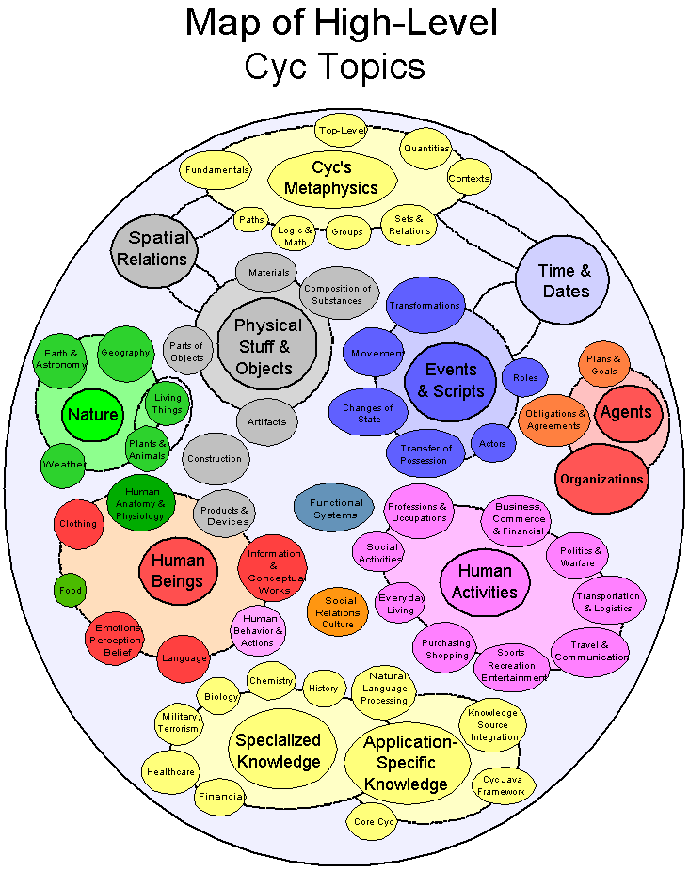
Topic Map – Top Level

Slide 7
OpenCyc Fundamentals
Symbolic concepts are represented as atomic terms, e.g. TransportationDevice, or a composed terms, e.g. (FruitFn AppleTree)
Besides concepts, terms can also be literals, e.g. true, false, “abcdef”, 1.0.
Relations about terms are represented by assertions, having a named predicate and from one to six argument positions filled by a term or another assertion
Each assertion is placed in a context, called a microtheory. These contexts are also terms and are arranged by OpenCyc into a generalization hierarchy for inference
Categories of OpenCyc concepts
  Collection (RDF Class)
  Individual (RDF Individual)
  Predicate (RDF Property)
  Microtheory (RDF named graph)
Single rooted concept hierarchy with Thing at the top
Multiple inheritance
Class cross-cutting aspects
  Temporal vs non-temporal
  Object-like vs Stuff-like
  Partially-tangible vs intangible
  Individual vs SetOrCollection
  Whether something is a situation or not

Slide 8
A Tour of OpenCyc
OpenCyc.org here
  A lot of documentation and tutorials
  Cyc 101 – periodic Cyc classes in Austin
Doug Lenat’s presentation at Google here
Knowledge Base browser here
  Definitional assertions
  Hierarchy browser
Cyc Foundation OpenCyc endpoint here
Cyc vocabulary introduction (e.g. event actors) here
Hosted at SourceForge

Slide 9
Linking Open Data
Databases and other structured knowledge sources expose their contents to the World Wide Web
Each exposed concept is identified with a URI, i.e. web address
The address returns something descriptive to humans when viewed with a browser
Relationships between concepts are expressed as RDF statements: subject, predicate (i.e. property), object, and optional context
OWL and RDF provide standard schema defining properties: rdf:type, rdfs:subClassOf, owl:sameAs, etc.
Linked Open Data forms part of the Semantic Web infrastructure. Now need to construct the intelligent agents that use the linked data.
OpenCyc is a contender for the standard ontology for linking open data
The UMBEL topic ontology was derived from OpenCyc and has 20000 class terms
Notable LOD datasets:
  DBPedia – derived from Wikipedia
  YAGO – 20 million facts about 2 million named enties
  GeoNames – 6.5 million facts about geographical locations

Slide 10
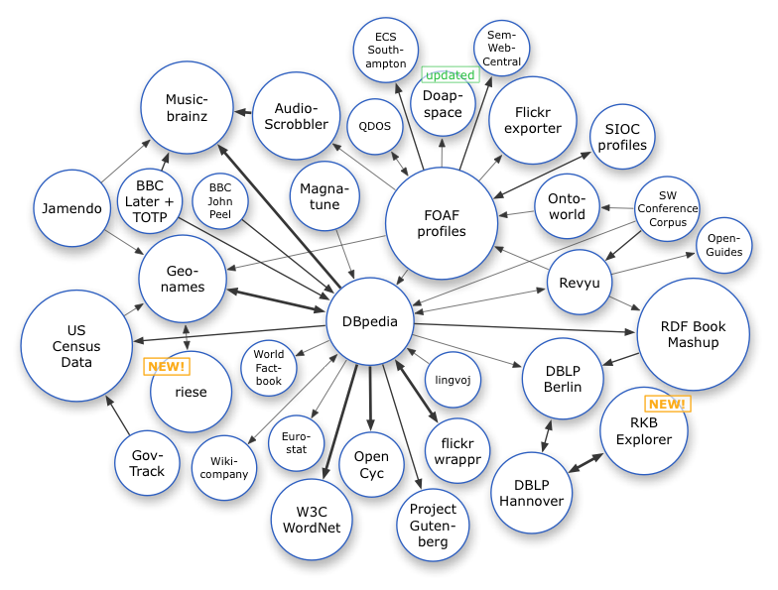
Linked Data Cloud illustrating knowledge source integration via shared ontology

Slide 11
“Learn proper nouns” → logic
Assignment-Obligation2 rdf:type cyc:Assignment-Obligation .
Assignment-Obligation2 cyc:allottedAgents Addressee .
Assignment-Obligation2 cyc:assigner Speaker .
Assignment-Obligation2 assignmentPostCondition Learning3 .
Learning3 typeOrSubClassOf cyc:Learning .
Learning3 cyc:actionFulfillsAssignment Assignment-Obligation2 .
Learning3 cyc:situationConstituents Addressee .
Learning3 cyc:performedBy Addressee .
Learning3 cyc:thingComprehended ProperCountNoun1 .
Learning3 fcgDiscourseRole Addressee .
Learning3 fcgStatus SingleObject .
Learning3 situationHappeningOnDate cyc:Now .
ProperCountNoun1 typeOrSubClassOf cyc:ProperCountNoun .
ProperCountNoun1 fcgDiscourseRole External .
ProperCountNoun1 fcgStatus MultipleObjects .
( you )
learn
proper nouns

Slide 12
‘BethLynn Maxwell is a proper noun → logic
LexicalWord1 rdf:type FCGClauseSubject .
LexicalWord1 typeOrSubClassOf cyc:LexicalWord .
LexicalWord1 cyc:wordStrings "BethLynn Maxwell" .
LexicalWord1 fcgDiscourseRole External .
LexicalWord1 fcgStatus SingleObject .
ImplicationSituation3 typeOrSubClassOf ImplicationSituation .
ImplicationSituation3 cyc:situationConstituents LexicalWord1 .
ImplicationSituation3 implicationAntecedant LexicalWord1 .
ImplicationSituation3 implicationConsequent ProperCountNoun2 .
ImplicationSituation3 fcgDiscourseRole External .
ImplicationSituation3 fcgStatus SingleObject .
ImplicationSituation3 situationHappeningOnDate cyc:Now .
ProperCountNoun2 typeOrSubClassOf IndefiniteThingInThisDiscourse .
ProperCountNoun2 typeOrSubClassOf cyc:ProperCountNoun .
ProperCountNoun2 fcgDiscourseRole External .
ProperCountNoun2 fcgStatus SingleObject .
‘Bethlynn’
is
a proper noun

Slide 13
SPARQL that matches “X is a proper noun”
PREFIX rdf: <http://www.w3.org/1999/02/22-rdf-syntax-ns#>
PREFIX cyc: <http://sw.cyc.com/2006/07/27/cyc/>
PREFIX texai: <http://texai.org/texai/>
SELECT ?LexicalWord1 ?CharacterString
WHERE {
?LexicalWord1 cyc:wordStrings ?CharacterString .
?LexicalWord1 rdf:type cyc:LexicalWord .
?ProperCountNoun2 rdf:type cyc:ProperCountNoun .
_:ImplicationSituation3 texai:implicationAntecedant ?LexicalWord1 .
_:ImplicationSituation3 texai:implicationConsequent ?ProperCountNoun2 .
}
Texai uses this query to perceive that the character string ‘BethLynn’ is to be used when creating the morphological rule for the corresponding proper noun

Slide 14
OpenCyc Annoyances
Does not include the several million commonsense assertions and rules from full proprietary Cyc
  ResearchCyc does that
OpenCyc’s inference engine and object store are not free software
No current provision for vetting and incorporating volunteer ontology input
Continues as an incompatible superset of the Semantic Web (W3C) RDF/OWL standard
Authored by philosophers and mathematicians, thus an impedance mismatch with the needs of computational linguists
Fine cross-cutting distinctions in the upper ontology make integration of lower level concepts more difficult – i.e. disjointness is rampant
Due to staff turnover, the passage of time, initially poor authoring guidelines, and until a few years ago – lack of unit tests, quality (e.g. well-formedness) and coverage is inconsistent
  Cyc authored what its sponsors funded
Often there are multiple approaches to encoding the same knowledge
  Davidsonian events vs direct assertions between role players in an event

Slide 15
Summary & Questions
At some point in AGI development, it will be useful to incorporate OpenCyc content
Likewise, Linked Open Data, mapped with a shared ontology, is a useful knowledge source input to an AGI, or conversely a means by which an AGI can disseminate its own knowledge.
Questions???
And enjoy the rest of AGI-09!

